Slide 1
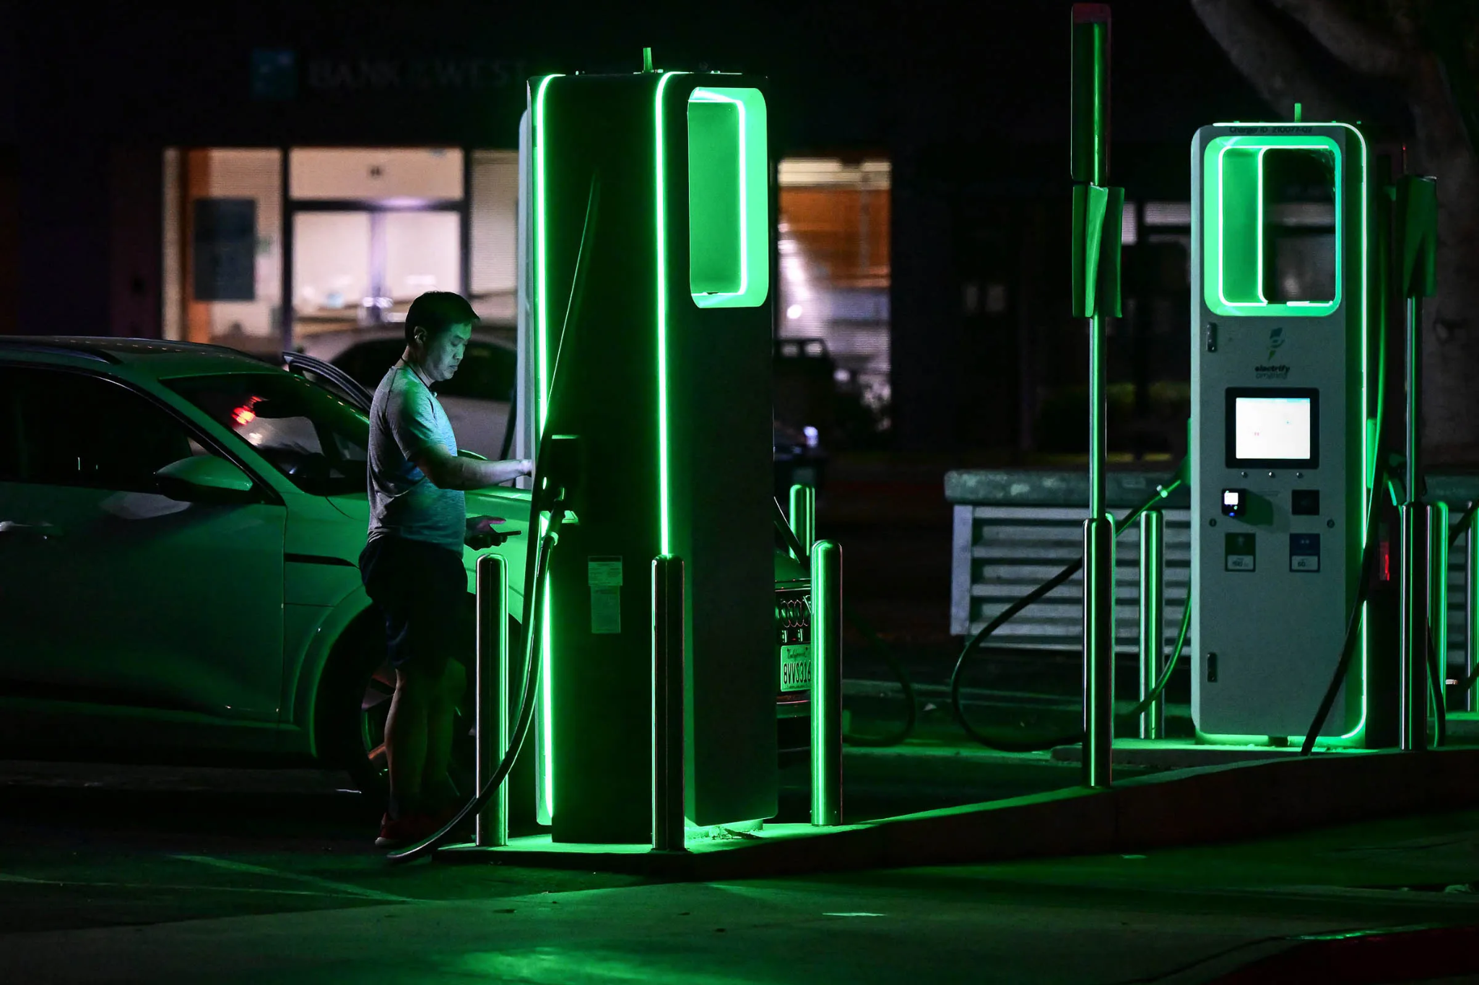
Global EV & Hydrogen Market
Ankit Pandey - 437949
Husnain Mustafa - 454398

Slide 2
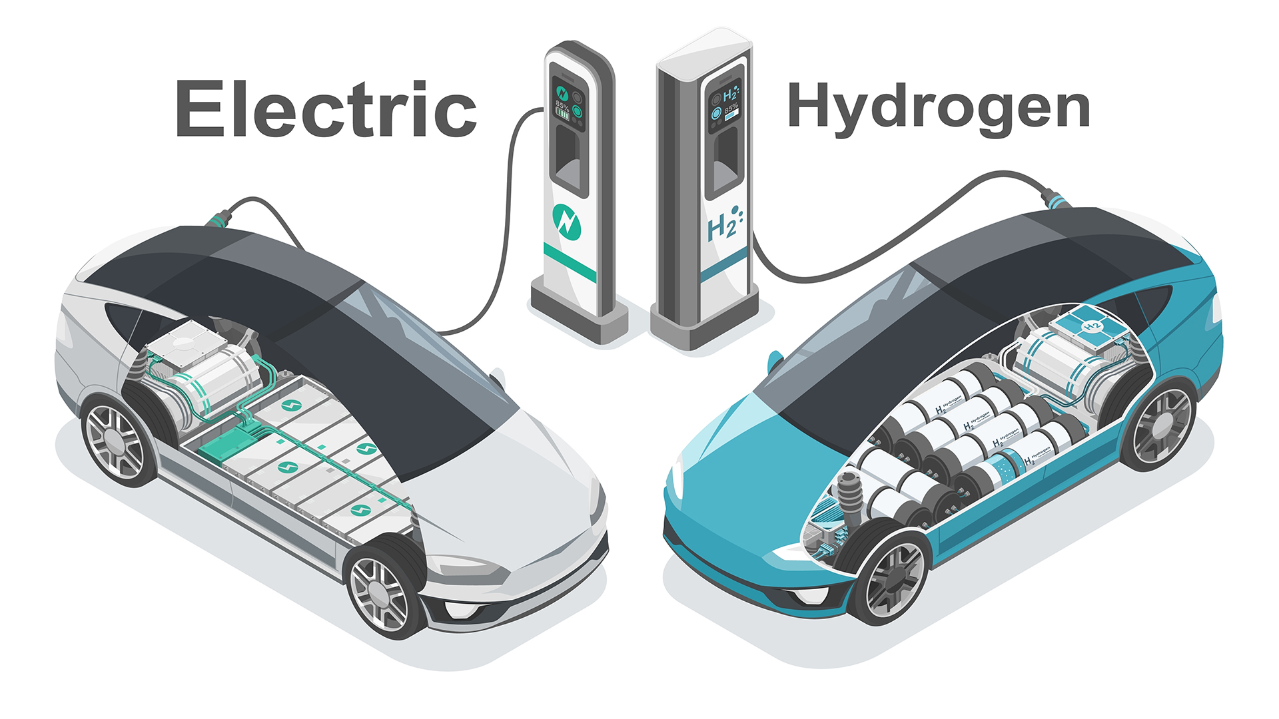
Introduction
Global EV market value to reach $802.81 billion by 2027: The EV market is growing rapidly, with significant investments from both private and public sectors.
Key regions leading in EV adoption: China, Europe, USA: China leads with expected sales of 9.1 million units in 2024, capturing 40% of the market.
Market penetration rates: Europe is projected to reach 3.9 million units (24.2% market share) and the USA 2.2 million units (12.5% penetration rate) by 2024.

Slide 3
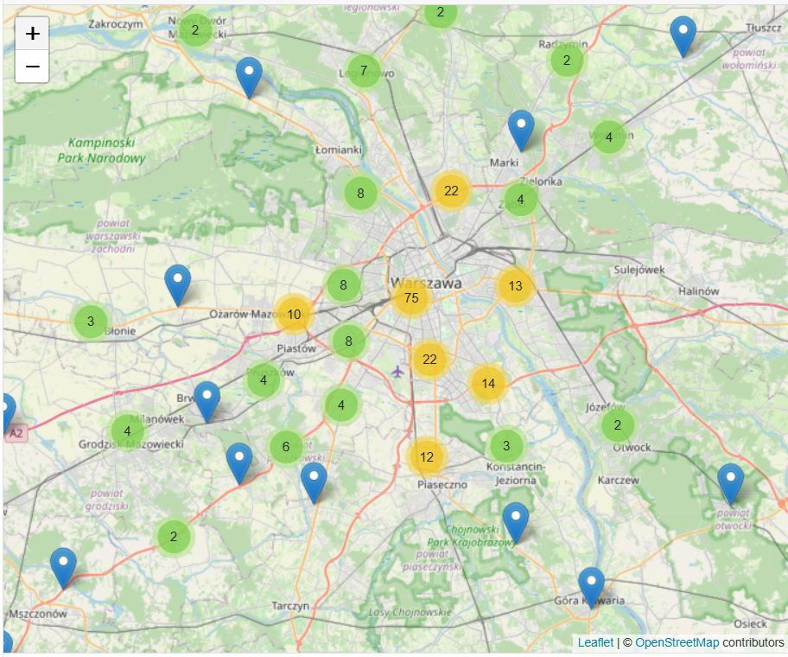
In key regions, the market dynamics are as follows:
Development of Smart Charging Networks
Establish a network of smart EV charging stations integrated with real-time data analytics and mobile applications to optimize charging schedules, monitor usage, and provide dynamic pricing.
EV Fleet Management Solutions
Offer comprehensive EV fleet management services for logistics companies, public transport, and corporate fleets

Slide 4



EV ecosystem in Poland
Infra Management System
EV fleet management Solutions
Electric B2C Charging Solutions

Slide 5

Business Point of View:
Specializing in EV Leasing and Charging Stations.
Wide range of electric cars and adoption support.
Easing the switch to electric vehicles for businesses and individuals.

Slide 6

Conclusion
Summary of key findings: The EV market is poised for significant growth, driven by technological advancements and strong policy support.
Policy recommendations: Governments should continue to provide incentives, invest in infrastructure, and support research and development.
Strategic investment opportunities: Investing in battery technology, charging infrastructure, and EV manufacturing can yield substantial returns.
Importance of public awareness: Raising public awareness through campaigns can accelerate EV adoption and foster market growth.

